Slide 1

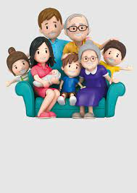
FAMILY – The start of life
Family is a group of people brought by birth or
sometimes by even common motive. Families are both small and large in size. Members of the immediate family includes Spouses, Parents, brothers, sisters, sons and / or daughters. Members of the extended family may include grandparents, aunts, uncles, cousins, nephews and nieces.
In most societies, The family is the principal institution for the socialization of children. Family is the first educational
institution for a child.
Families are mainly of two types –
Nuclear Family – It includes only the husband, wife and Unmarried children who are young
Joint Family – It includes a whole range of members
like grandparents, parents, aunt, son/daughter and
cousins.

